Slide 1
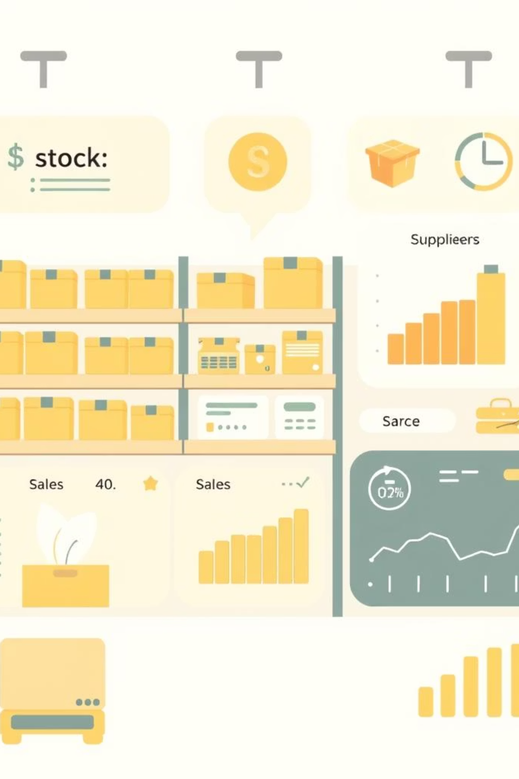
📦 Inventory Management System – SQL-Based Project
Managing Stock, Suppliers, Purchases, and Sales Efficiently Using SQL
Presented by: Tanvi Chougule
Date: August 2025

Slide 2
Project Overview
Objective: Build a relational database to manage an organization’s inventory using SQL.
Track Product Stock
Manage Supplier Orders
Record Sales
Monitor Low Inventory
Generate Business Reports

Slide 3
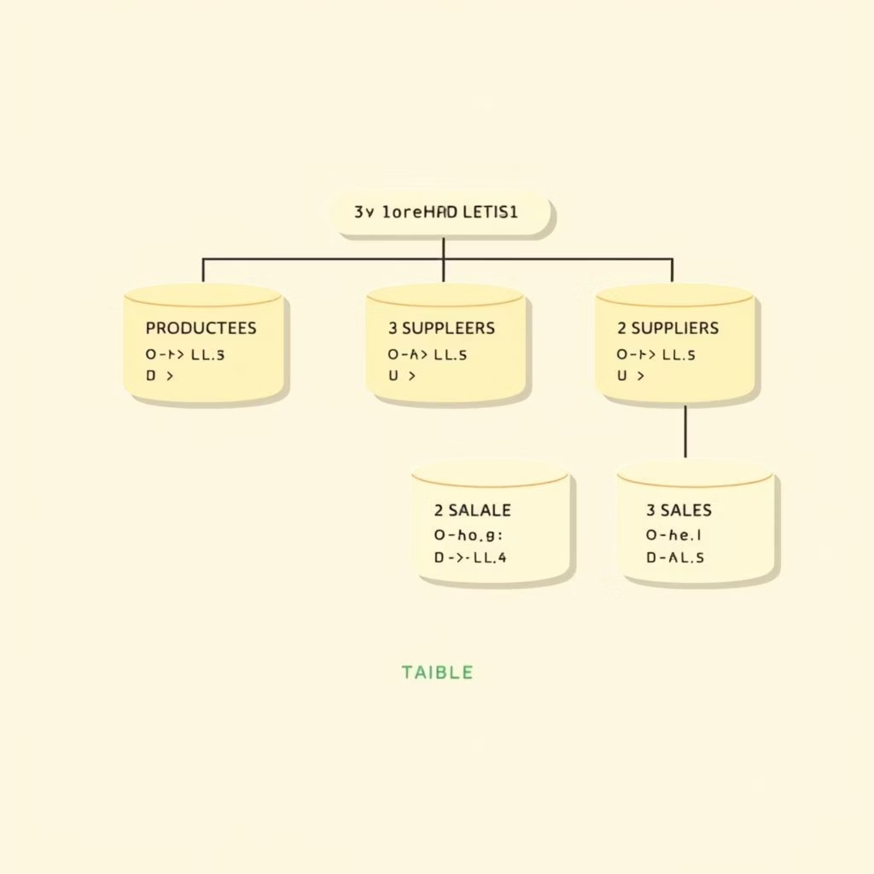
Database Design: Core Tables
PRODUCTS: Items and stock levels
SUPPLIERS: Vendor details
PURCHASE_ORDERS: Orders from suppliers
PURCHASE_ORDER_ITEMS: Items in purchase orders
SALES: Customer sales and stock movement
EER Diagram for visual representation

Slide 4
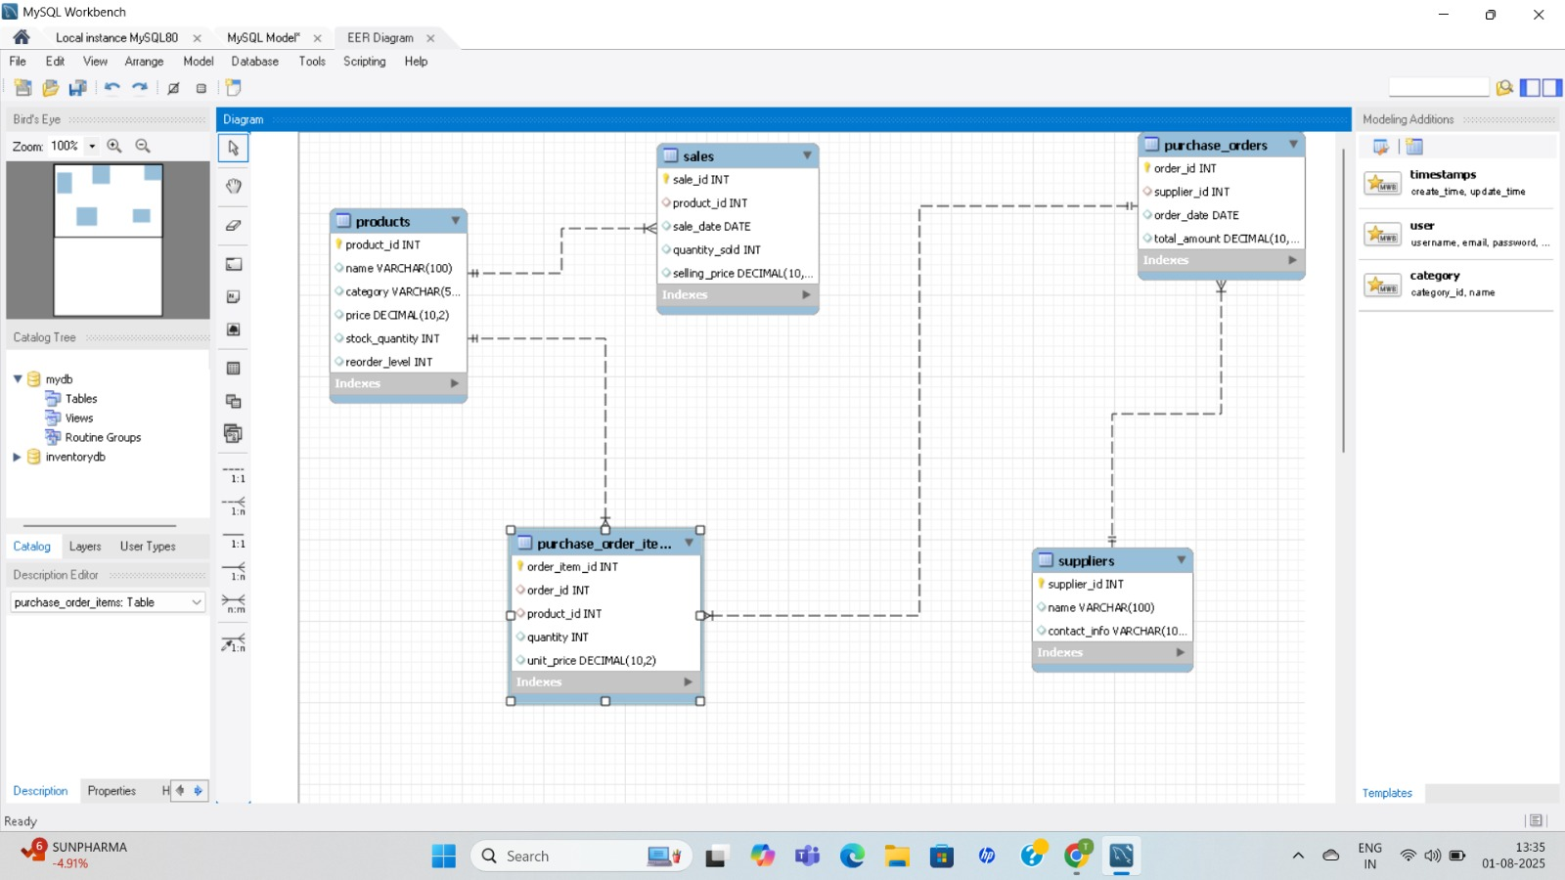

Slide 5
SQL Schema Creation
CREATE TABLE PRODUCTS (...);CREATE TABLE SUPPLIERS (...);CREATE TABLE PURCHASE_ORDERS (...);CREATE TABLE PURCHASE_ORDER_ITEMS (...);CREATE TABLE SALES (...);
✅ Foreign keys maintain relational integrity
✅ Primary keys ensure unique identification

Slide 6
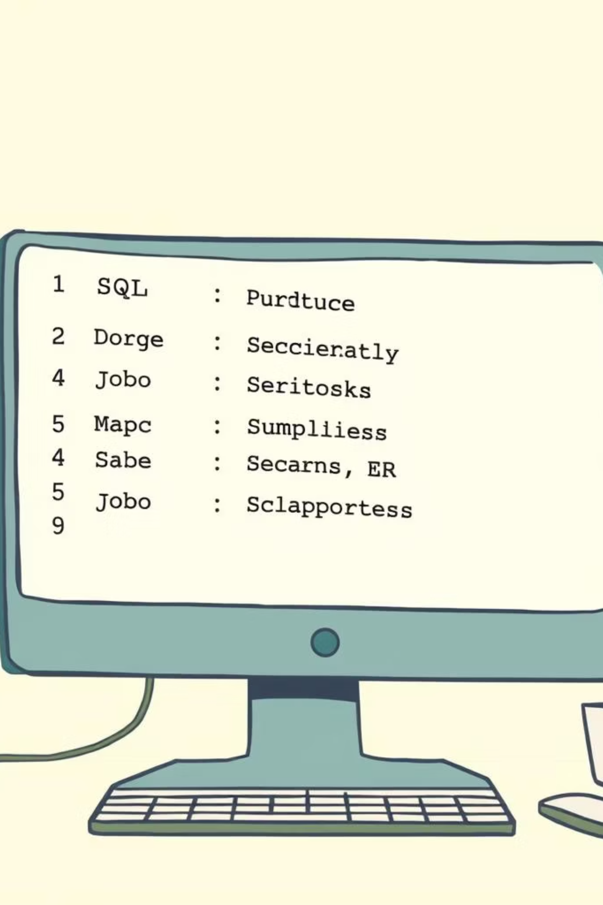
Data Insertion
INSERT INTO PRODUCTS VALUES (...);INSERT INTO SUPPLIERS VALUES (...);INSERT INTO PURCHASE_ORDERS VALUES (...);INSERT INTO PURCHASE_ORDER_ITEMS VALUES (...);INSERT INTO SALES VALUES (...);
🎯 Used realistic data: 4 products, 2 suppliers, sample sales.

Slide 7
Basic Queries for Inventory Insights
1
2
3
View All Stock
Low Stock Alert
Total Stock Value
SELECT * FROM PRODUCTS;
WHERE stock_quantity < reorder_level;
SUM(price * stock_quantity)
Purpose: Inventory review, replenishment tracking, budgeting.

Slide 8
JOIN Queries: Connecting Data
Joins provide complete business insights by linking related tables.
SELECT P.name, S.quantity_soldFROM SALES SJOIN PRODUCTS P ON S.product_id = P.product_id;
Products ↔ Sales
Products ↔ Suppliers
Purchase Orders ↔ Suppliers
Purchase Items ↔ Products

Slide 9




Reports & Key Insights
Top-Selling Products
Monthly Revenue
Supplier Spending
Unsold Products
SELECT P.name, SUM(S.quantity_sold)FROM SALES S JOIN PRODUCTS PGROUP BY P.name;

Slide 10
Business Impact & Future Enhancements
Key Business Impact
Future Enhancements
Track low stock items
Add Triggers for auto stock updates
Evaluate supplier performance
Add Stored Procedures for reporting
Understand sales trends
Connect to Power BI for dashboards
Plan future orders effectively
Implement User Roles & Security
Prevent stockouts & overstocking
Expand to multi-location inventory

Slide 11

Thank You!
Questions?
Let’s talk inventory optimization through SQL!

